Slide 1

Using Acoustic Telemetry Data and Environmental Variables to Predict White Shark Presence in Southern California
Photo by Ralph Pace
Echelle Burns – Dec 2019

Slide 2

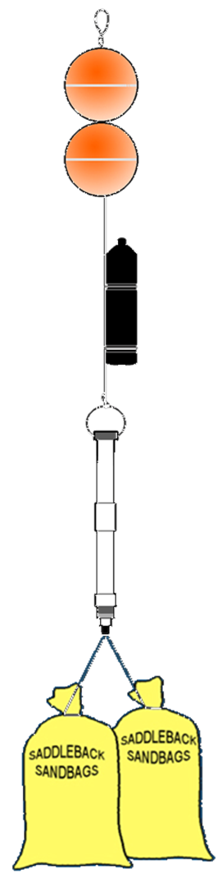
Introduction: Acoustic Telemetry
Common tool to study animal movements
Transmitters emit ultrasonic sound
Acoustic receiver picks up transmitter signal
Records: Date, Time, Transmitter Code, Mooring Location
Notes:
In acoustic telemetry, fish are typically fitted with acoustic transmitter that emit a sound wave that is picked up by underwater acoustic receivers. The receiver records the date, time, and tagID of the individual that was within its detection range.
The transmitters used for this study were Vemco V9 transmitters. they randomly send out a signal every 100 to 180 seconds, have a battery life of about one year, and a nominal detection distance of about 500 m.

Slide 3
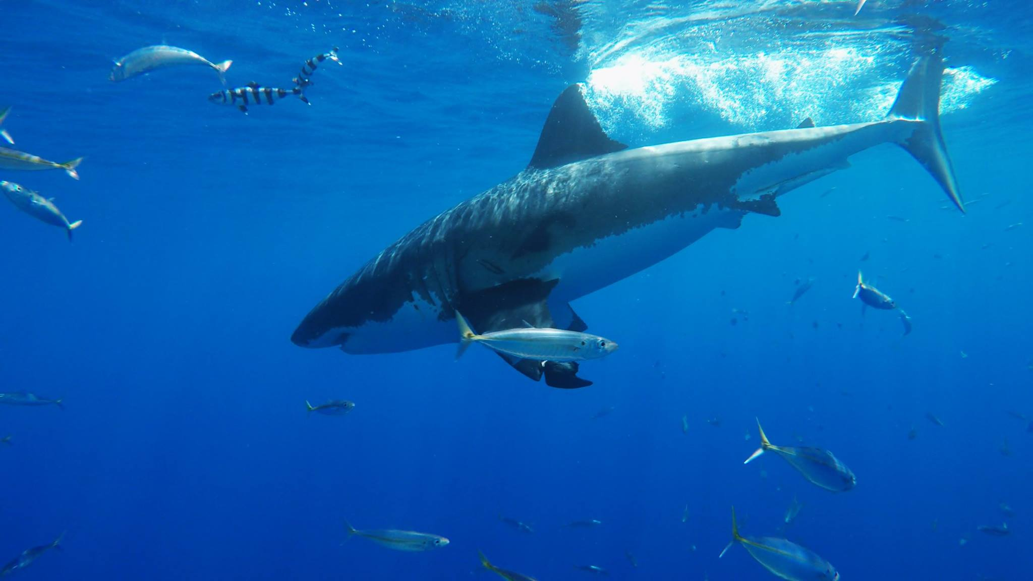
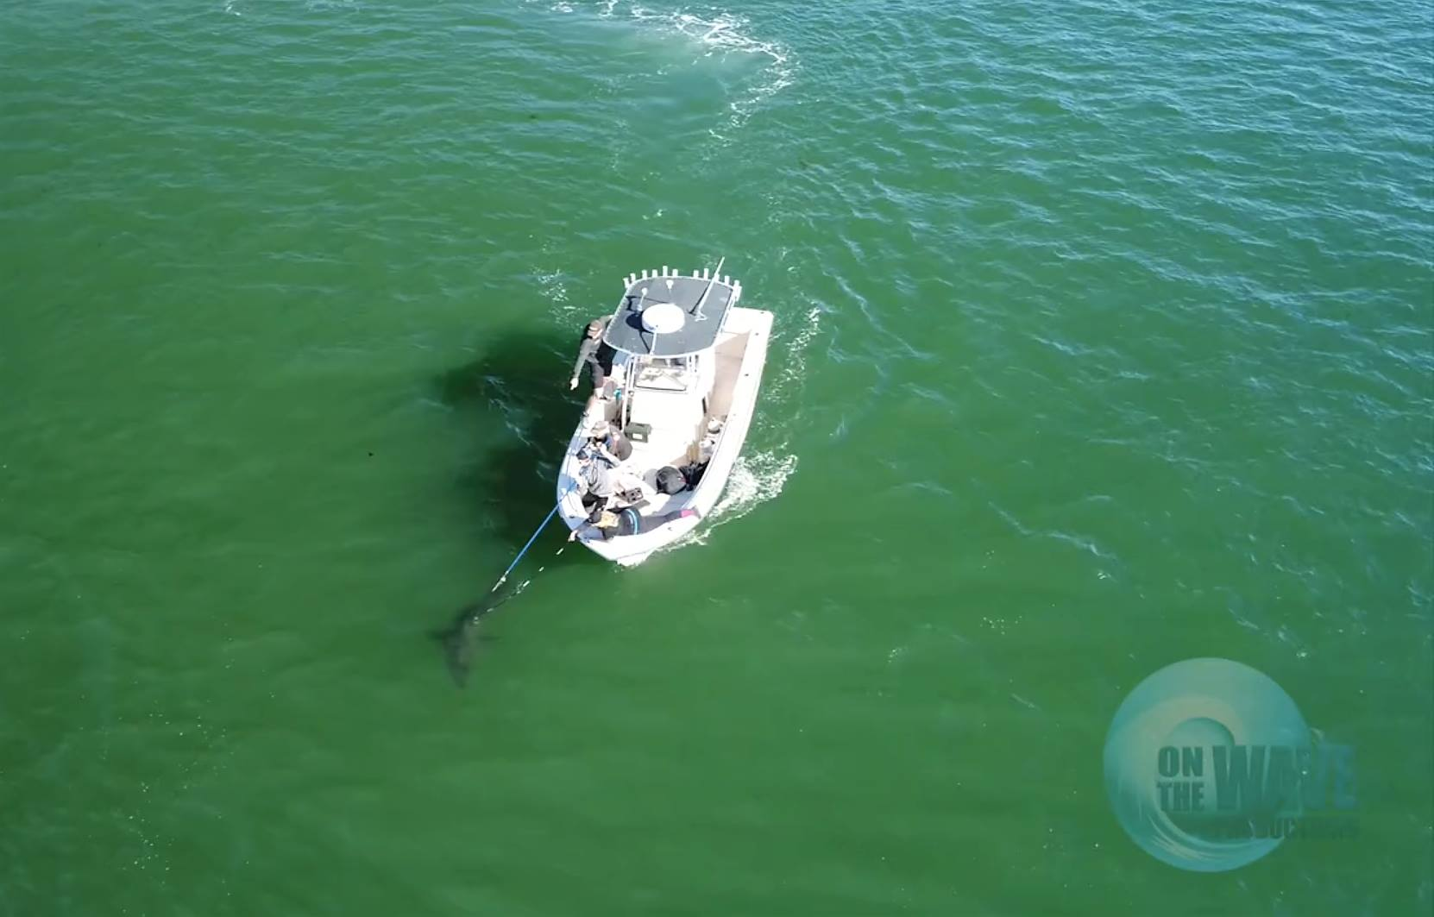
Introduction: Study Species
Juvenile White Sharks (Carcharodon carcharias)
Apex predator with a global distribution
Repeated movements to nearshore waters off southern California
Seasonal/annual scale
Running hypothesis: Temperature Driven?
Notes:
In acoustic telemetry, fish are typically fitted with acoustic transmitter that emit a sound wave that is picked up by underwater acoustic receivers. The receiver records the date, time, and tagID of the individual that was within its detection range.
The transmitters used for this study were Vemco V9 transmitters. they randomly send out a signal every 100 to 180 seconds, have a battery life of about one year, and a nominal detection distance of about 500 m.

Slide 4
Introduction: Project Objectives
Objectives:
Determine which combinations of environmental parameters influence White Shark presence in southern CA
Predict ranges of environmental conditions that are most likely to result in high densities of White Sharks
Audience:
Researchers using similar species or technology
Lifeguards and public safety personnel
Notes:
In acoustic telemetry, fish are typically fitted with acoustic transmitter that emit a sound wave that is picked up by underwater acoustic receivers. The receiver records the date, time, and tagID of the individual that was within its detection range.
The transmitters used for this study were Vemco V9 transmitters. they randomly send out a signal every 100 to 180 seconds, have a battery life of about one year, and a nominal detection distance of about 500 m.

Slide 5
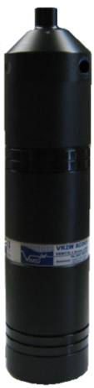
Materials and Methods: Data Sources
Cal State University, Long Beach Shark Lab:
Receiver Deployment Log
When and where receivers were deployed
Transmitter Deployment Log
Tagging date, location, species
Receiver Data (2012 – 2019)
Detection data from nearby animals
Notes:
In acoustic telemetry, fish are typically fitted with acoustic transmitter that emit a sound wave that is picked up by underwater acoustic receivers. The receiver records the date, time, and tagID of the individual that was within its detection range.
The transmitters used for this study were Vemco V9 transmitters. they randomly send out a signal every 100 to 180 seconds, have a battery life of about one year, and a nominal detection distance of about 500 m.

Slide 6
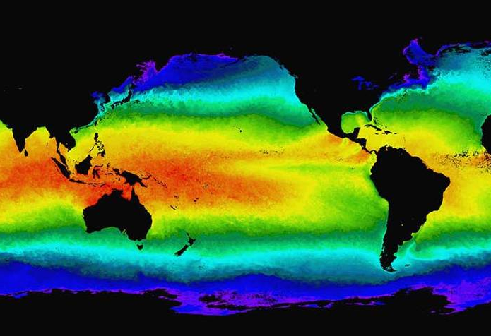
Materials and Methods: Data Sources
NOAA CoastWatch ERDDAP
Sea Surface Temperature (SST)
Sea Surface Salinity (SSS)
Chlorophyll-A
Seafloor Depth Gradient (seafloor slope)
Pylunar package – lunar phase
Notes:
In acoustic telemetry, fish are typically fitted with acoustic transmitter that emit a sound wave that is picked up by underwater acoustic receivers. The receiver records the date, time, and tagID of the individual that was within its detection range.
The transmitters used for this study were Vemco V9 transmitters. they randomly send out a signal every 100 to 180 seconds, have a battery life of about one year, and a nominal detection distance of about 500 m.

Slide 7
Materials and Methods: Data Cleaning
Acoustic Receiver Data
White Sharks (WS) only
Individual heard 2+ times per day at a receiver
Receiver confirmed to have been in the water
Latitude/Longitude reflect receiver deployment location
Result: WS detection data from 2014 to 2019
WS 01 2017-11-01 11:52:01
WS 01 2017-11-01 12:11:58
Notes:
In acoustic telemetry, fish are typically fitted with acoustic transmitter that emit a sound wave that is picked up by underwater acoustic receivers. The receiver records the date, time, and tagID of the individual that was within its detection range.
The transmitters used for this study were Vemco V9 transmitters. they randomly send out a signal every 100 to 180 seconds, have a battery life of about one year, and a nominal detection distance of about 500 m.

Slide 8
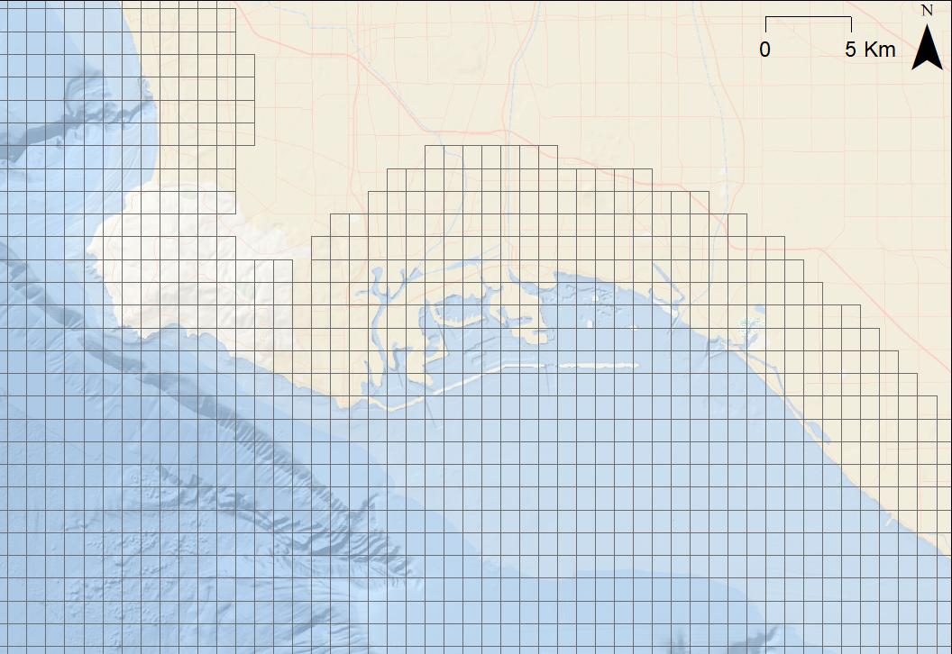
Materials and Methods: Data Cleaning
Fishnet 0.01 x 0.01 decimal degree (ArcMap)
Long Beach, CA
To merge environmental data with acoustic receiver data
Notes:
In acoustic telemetry, fish are typically fitted with acoustic transmitter that emit a sound wave that is picked up by underwater acoustic receivers. The receiver records the date, time, and tagID of the individual that was within its detection range.
The transmitters used for this study were Vemco V9 transmitters. they randomly send out a signal every 100 to 180 seconds, have a battery life of about one year, and a nominal detection distance of about 500 m.

Slide 9
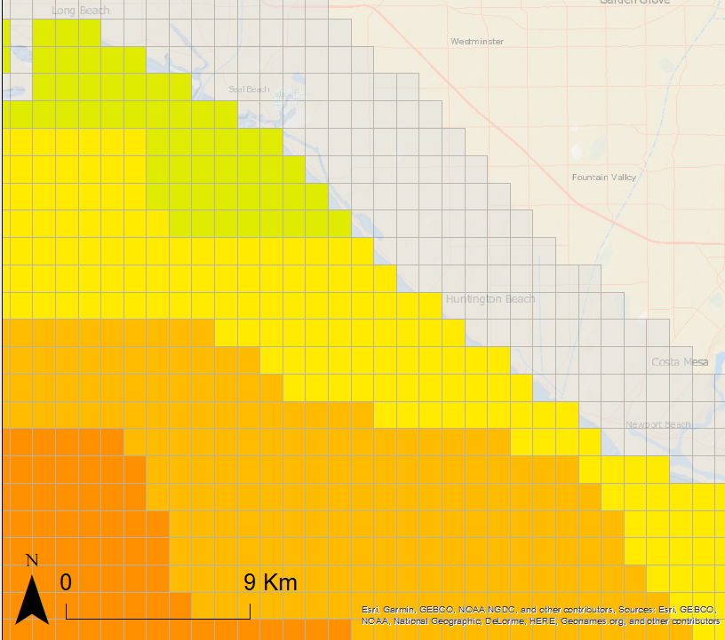
Materials and Methods: Data Cleaning
Fishnet 0.01 x 0.01 decimal degree (ArcMap)
Long Beach, CA
Nearest Neighbor for cells too close to shore
Mean value if > 1 measurements per cell
To merge environmental data with acoustic receiver data
Notes:
In acoustic telemetry, fish are typically fitted with acoustic transmitter that emit a sound wave that is picked up by underwater acoustic receivers. The receiver records the date, time, and tagID of the individual that was within its detection range.
The transmitters used for this study were Vemco V9 transmitters. they randomly send out a signal every 100 to 180 seconds, have a battery life of about one year, and a nominal detection distance of about 500 m.

Slide 10
Materials and Methods: Data Cleaning
Zero-Inflated Dataset
Analyzed by year
Kept all data where sharks were present
Jackknifed data where sharks were absent
Sample size = size of dataset with sharks
Only zones present in dataset with sharks (±10 zone IDs)
Other zones used only if necessary
SST
High
Low
Notes:
In acoustic telemetry, fish are typically fitted with acoustic transmitter that emit a sound wave that is picked up by underwater acoustic receivers. The receiver records the date, time, and tagID of the individual that was within its detection range.
The transmitters used for this study were Vemco V9 transmitters. they randomly send out a signal every 100 to 180 seconds, have a battery life of about one year, and a nominal detection distance of about 500 m.

Slide 11
Materials and Methods: Data Cleaning
Individual shark data changed to # unique sharks per zone per day (Shark Density)
Final Dataset
Response: Shark Density
Categorical Predictors:
Month
Year
Zone ID
Receiver Density
Lunar Phase
Continious Predictors:
SST
SSS
Chlorophyll-A
Seafloor depth gradient
Notes:
In acoustic telemetry, fish are typically fitted with acoustic transmitter that emit a sound wave that is picked up by underwater acoustic receivers. The receiver records the date, time, and tagID of the individual that was within its detection range.
The transmitters used for this study were Vemco V9 transmitters. they randomly send out a signal every 100 to 180 seconds, have a battery life of about one year, and a nominal detection distance of about 500 m.

Slide 12

Materials and Methods
Visual Assessments:
Data visually assessed for outliers
Statistical Analyses:
Only data where sharks were present
Ordinary Least Squares ANOVA (Receiver Density, Year, Zone ID)
Correlation Tests (SST, SSS, Chlorophyll-A, depth gradient)
Higher order polynomial functions if non-linear relationship
Notes:
In acoustic telemetry, fish are typically fitted with acoustic transmitter that emit a sound wave that is picked up by underwater acoustic receivers. The receiver records the date, time, and tagID of the individual that was within its detection range.
The transmitters used for this study were Vemco V9 transmitters. they randomly send out a signal every 100 to 180 seconds, have a battery life of about one year, and a nominal detection distance of about 500 m.

Slide 13

Results: Shark Density v Year
Ordinary Least Squares ANOVA
Shark Density across years compared to 2014
2015, 2016, 2017 >>> 2014 (p < 0.001)
2017 == 2014 (p = 0.153)
2019 <<< 2014 (p = 0.028)
Notes:
In acoustic telemetry, fish are typically fitted with acoustic transmitter that emit a sound wave that is picked up by underwater acoustic receivers. The receiver records the date, time, and tagID of the individual that was within its detection range.
The transmitters used for this study were Vemco V9 transmitters. they randomly send out a signal every 100 to 180 seconds, have a battery life of about one year, and a nominal detection distance of about 500 m.

Slide 14
Discussion: Shark Density v Year
2015, 2017, 2018 >>> 2014 (p < 0.001)
2016 == 2014 (p = 0.153)
2019 <<< 2014 (p = 0.028)
More ideal environmental conditions in 2015, 2017, 2018?
Fewer data in 2019 because the year is not yet over?
Notes:
In acoustic telemetry, fish are typically fitted with acoustic transmitter that emit a sound wave that is picked up by underwater acoustic receivers. The receiver records the date, time, and tagID of the individual that was within its detection range.
The transmitters used for this study were Vemco V9 transmitters. they randomly send out a signal every 100 to 180 seconds, have a battery life of about one year, and a nominal detection distance of about 500 m.

Slide 15

Results: Shark Density v Receiver Density
Ordinary Least Squares ANOVA
Shark Density across receiver densities
2 receivers >>> 1 receiver (p < 0.001)
3 receivers == 1 receiver (p = 0.625)
Notes:
In acoustic telemetry, fish are typically fitted with acoustic transmitter that emit a sound wave that is picked up by underwater acoustic receivers. The receiver records the date, time, and tagID of the individual that was within its detection range.
The transmitters used for this study were Vemco V9 transmitters. they randomly send out a signal every 100 to 180 seconds, have a battery life of about one year, and a nominal detection distance of about 500 m.

Slide 16
Discussion: Shark Density v Receiver Density
2 receivers >>> 1 receiver (p < 0.001)
3 receivers == 1 receiver (p = 0.625)
More receivers in a grid cell = more cell coverage
Few instances in which receiver density > 2 receivers
Notes:
In acoustic telemetry, fish are typically fitted with acoustic transmitter that emit a sound wave that is picked up by underwater acoustic receivers. The receiver records the date, time, and tagID of the individual that was within its detection range.
The transmitters used for this study were Vemco V9 transmitters. they randomly send out a signal every 100 to 180 seconds, have a battery life of about one year, and a nominal detection distance of about 500 m.

Slide 17
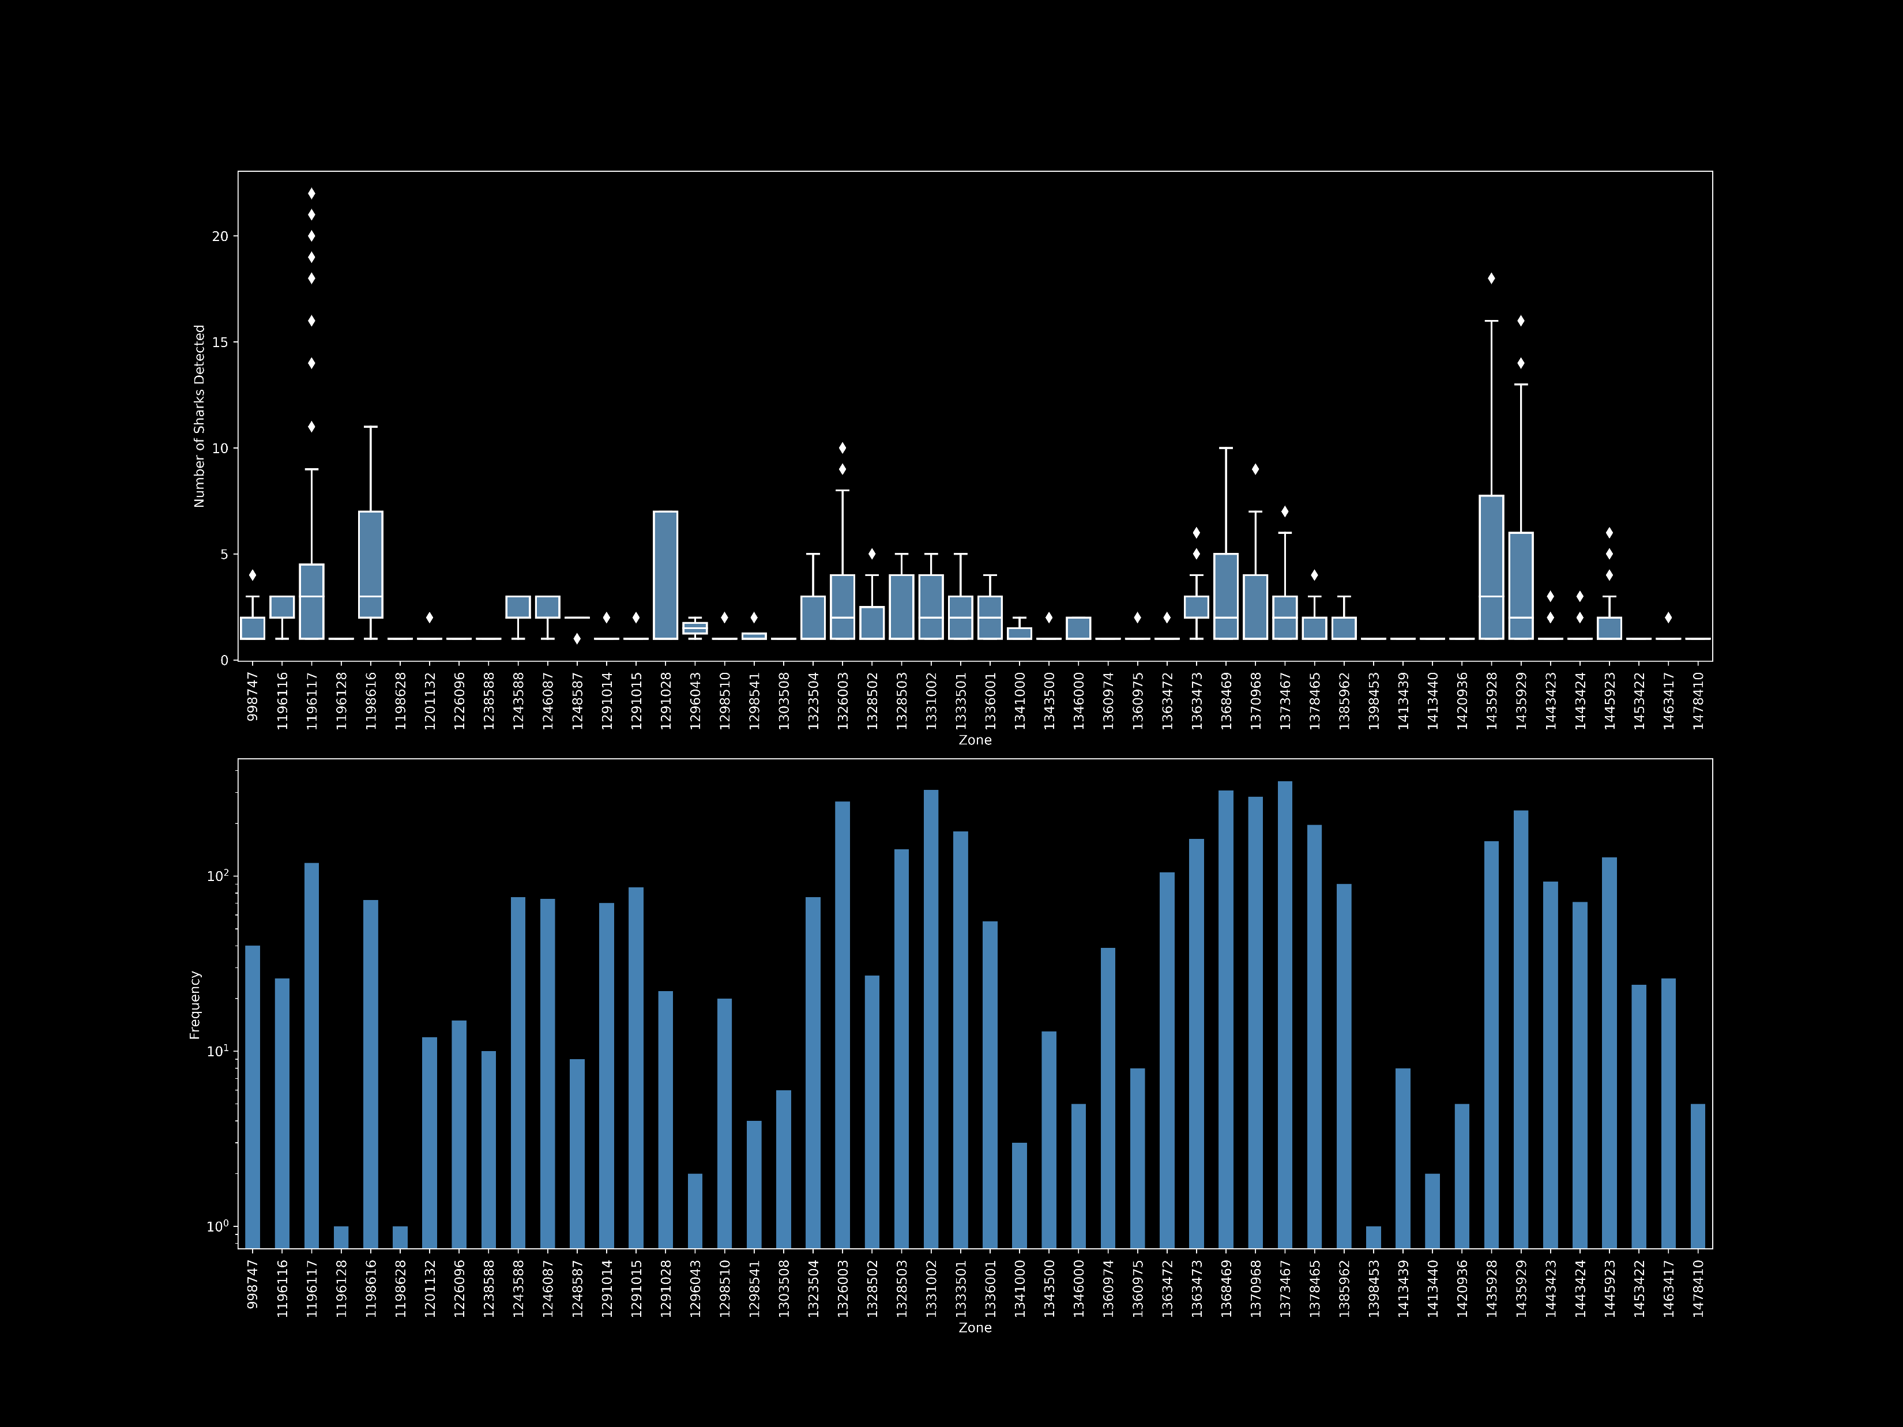
Results: Shark Density v Zone
Notes:
In acoustic telemetry, fish are typically fitted with acoustic transmitter that emit a sound wave that is picked up by underwater acoustic receivers. The receiver records the date, time, and tagID of the individual that was within its detection range.
The transmitters used for this study were Vemco V9 transmitters. they randomly send out a signal every 100 to 180 seconds, have a battery life of about one year, and a nominal detection distance of about 500 m.

Slide 18
Results and Discussion: Shark Density v Zone
Ordinary Least Squares ANOVA
Shark Density across zones
~ 8 zones showed significantly higher shark densities than others
May indicate ‘hotspot’ areas that juvenile white sharks use repeatedly
Notes:
In acoustic telemetry, fish are typically fitted with acoustic transmitter that emit a sound wave that is picked up by underwater acoustic receivers. The receiver records the date, time, and tagID of the individual that was within its detection range.
The transmitters used for this study were Vemco V9 transmitters. they randomly send out a signal every 100 to 180 seconds, have a battery life of about one year, and a nominal detection distance of about 500 m.

Slide 19
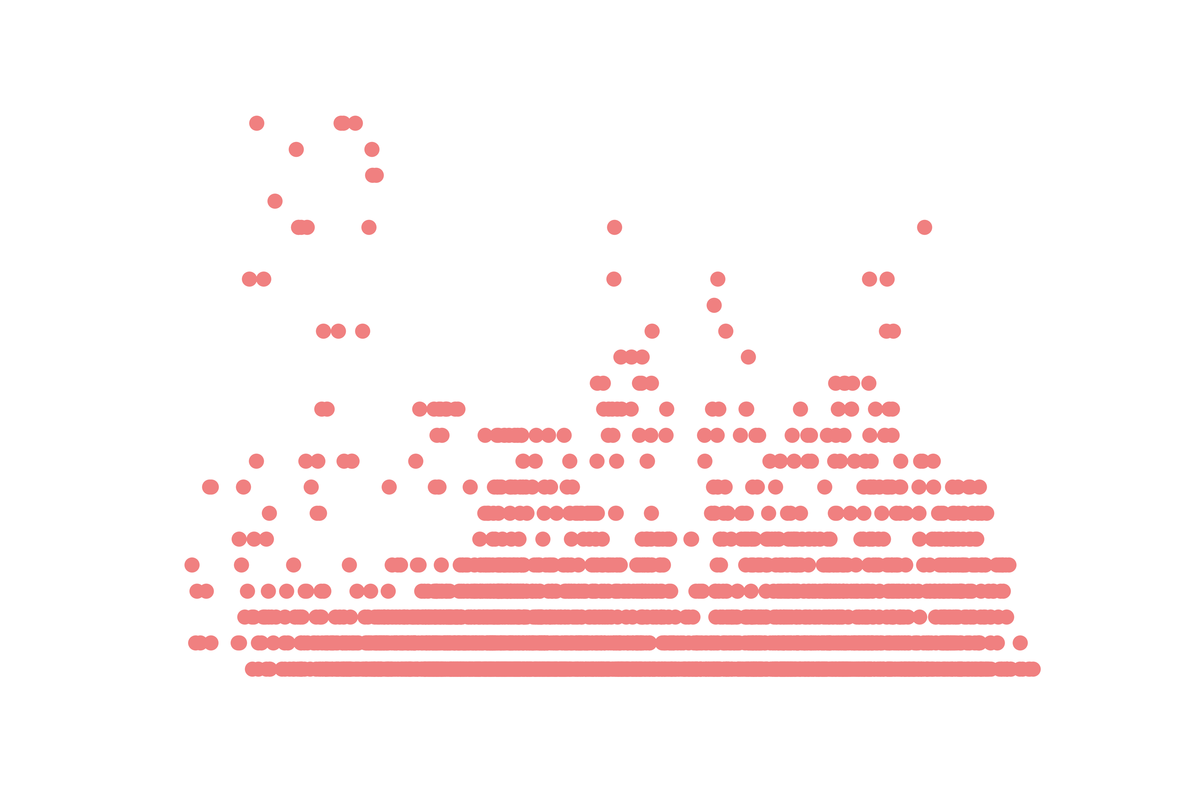
Results: Shark Density v Sea Surface Temperature
Min: 10.99
Max: 25
Median: 17.88
STD: 2.66
Highly variable shark densities at all temperature values
Notes:
In acoustic telemetry, fish are typically fitted with acoustic transmitter that emit a sound wave that is picked up by underwater acoustic receivers. The receiver records the date, time, and tagID of the individual that was within its detection range.
The transmitters used for this study were Vemco V9 transmitters. they randomly send out a signal every 100 to 180 seconds, have a battery life of about one year, and a nominal detection distance of about 500 m.

Slide 20

Results: Shark Density v Sea Surface Temperature
Peaks
2014: 16-17ºC
Different years show different relationships between SST and shark density.
Notes:
In acoustic telemetry, fish are typically fitted with acoustic transmitter that emit a sound wave that is picked up by underwater acoustic receivers. The receiver records the date, time, and tagID of the individual that was within its detection range.
The transmitters used for this study were Vemco V9 transmitters. they randomly send out a signal every 100 to 180 seconds, have a battery life of about one year, and a nominal detection distance of about 500 m.

Slide 21
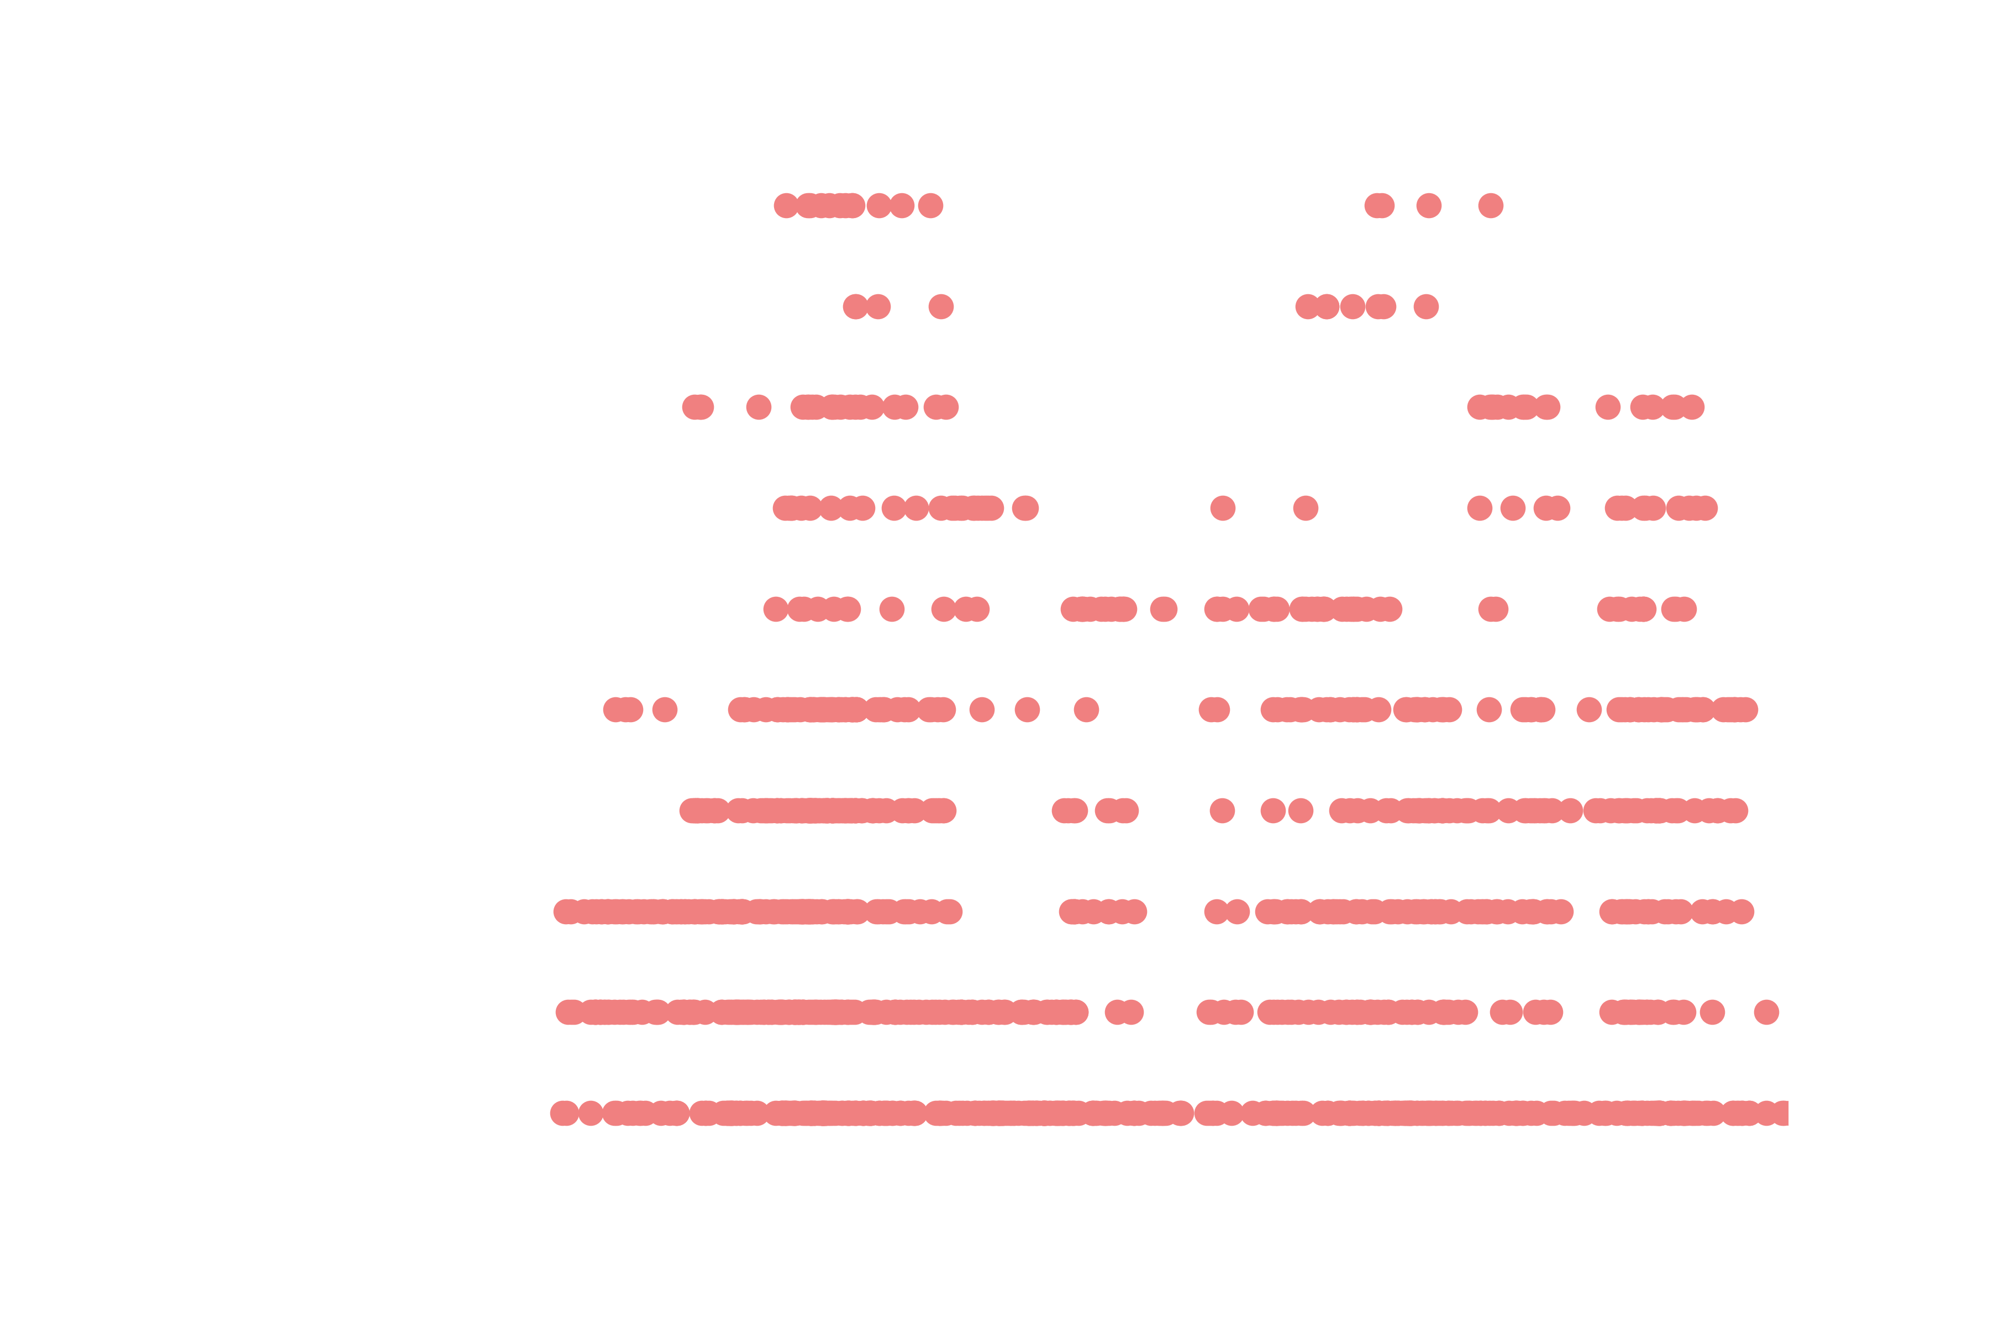
Results: Shark Density v Sea Surface Temperature
Peaks
2014: 16-17ºC
2015: 16-17ºC,
20-22ºC
Different years show different relationships between SST and shark density.
Notes:
In acoustic telemetry, fish are typically fitted with acoustic transmitter that emit a sound wave that is picked up by underwater acoustic receivers. The receiver records the date, time, and tagID of the individual that was within its detection range.
The transmitters used for this study were Vemco V9 transmitters. they randomly send out a signal every 100 to 180 seconds, have a battery life of about one year, and a nominal detection distance of about 500 m.

Slide 22

Results: Shark Density v Sea Surface Temperature
Peaks
2014: 16-17ºC
2015: 16-17ºC,
20-22ºC
2016: 14-18ºC
Different years show different relationships between SST and shark density.
Notes:
In acoustic telemetry, fish are typically fitted with acoustic transmitter that emit a sound wave that is picked up by underwater acoustic receivers. The receiver records the date, time, and tagID of the individual that was within its detection range.
The transmitters used for this study were Vemco V9 transmitters. they randomly send out a signal every 100 to 180 seconds, have a battery life of about one year, and a nominal detection distance of about 500 m.

Slide 23
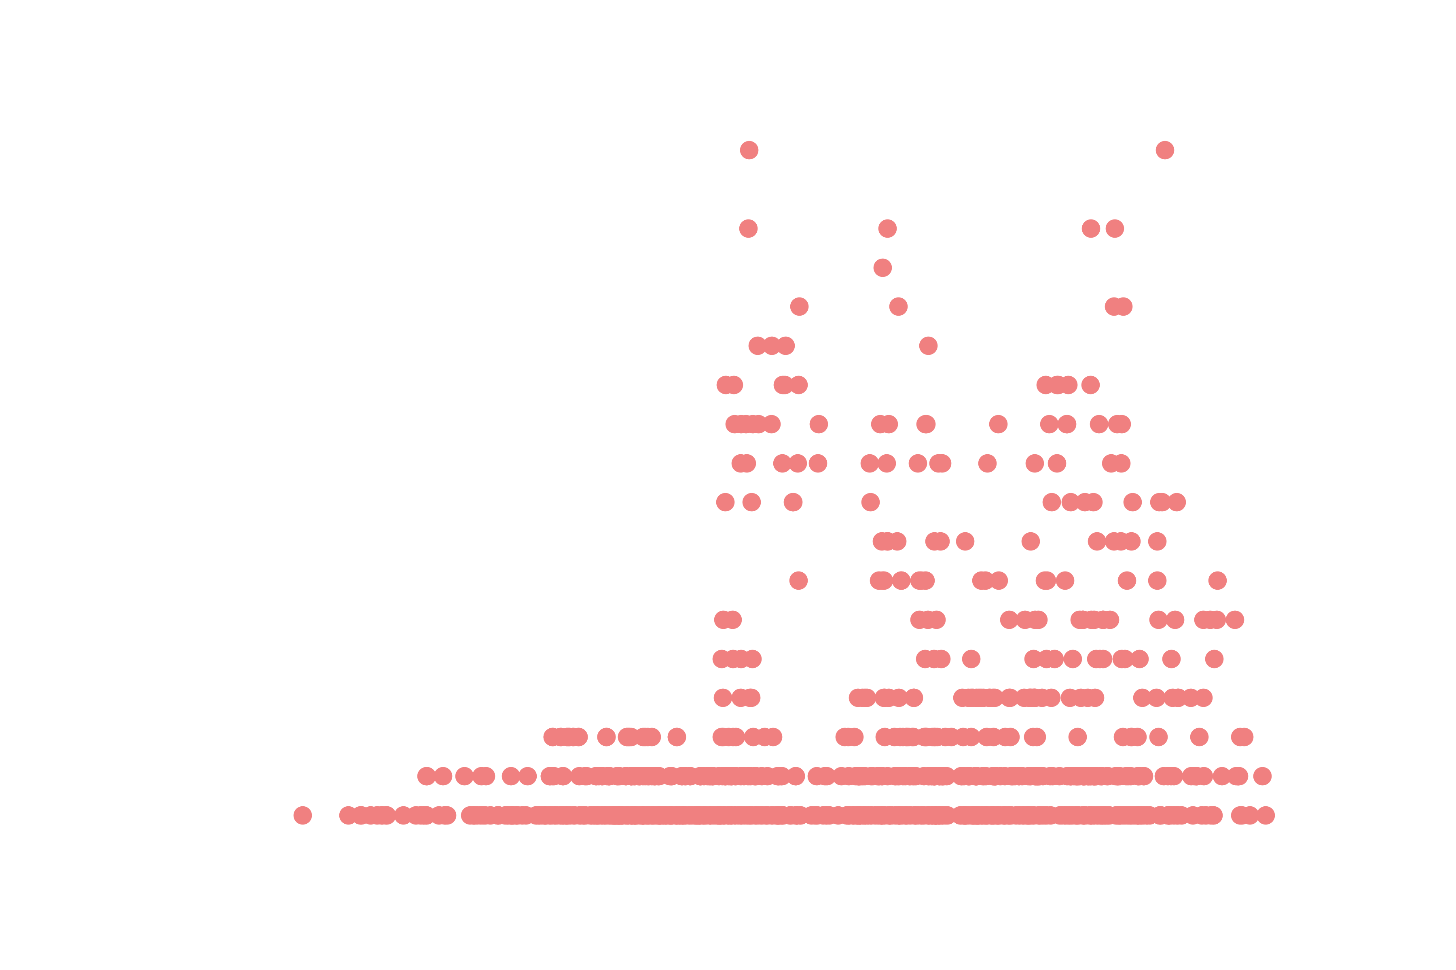
Results: Shark Density v Sea Surface Temperature
Peaks
2014: 16-17ºC
2015: 16-17ºC,
20-22ºC
2016: 14-18ºC
2017: 18-22ºC
Different years show different relationships between SST and shark density.
Notes:
In acoustic telemetry, fish are typically fitted with acoustic transmitter that emit a sound wave that is picked up by underwater acoustic receivers. The receiver records the date, time, and tagID of the individual that was within its detection range.
The transmitters used for this study were Vemco V9 transmitters. they randomly send out a signal every 100 to 180 seconds, have a battery life of about one year, and a nominal detection distance of about 500 m.

Slide 24
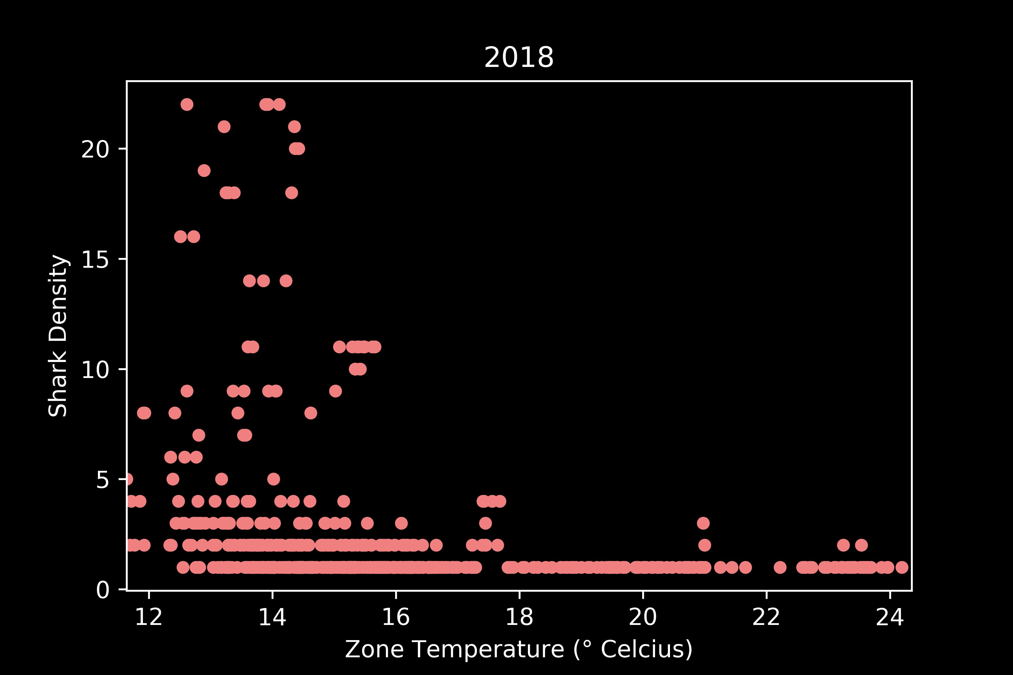
Results: Shark Density v Sea Surface Temperature
Peaks
2014: 16-17ºC
2015: 16-17ºC,
20-22ºC
2016: 14-18ºC
2017: 18-22ºC
2018: 12-14ºC
Different years show different relationships between SST and shark density.
Notes:
In acoustic telemetry, fish are typically fitted with acoustic transmitter that emit a sound wave that is picked up by underwater acoustic receivers. The receiver records the date, time, and tagID of the individual that was within its detection range.
The transmitters used for this study were Vemco V9 transmitters. they randomly send out a signal every 100 to 180 seconds, have a battery life of about one year, and a nominal detection distance of about 500 m.

Slide 25

Results: Shark Density v Sea Surface Temperature
Peaks
2014: 16-17ºC
2015: 16-17ºC,
20-22ºC
2016: 14-18ºC
2017: 18-22ºC
2018: 12-14ºC
2019: 13-14ºC
Different years show different relationships between SST and shark density.
Notes:
In acoustic telemetry, fish are typically fitted with acoustic transmitter that emit a sound wave that is picked up by underwater acoustic receivers. The receiver records the date, time, and tagID of the individual that was within its detection range.
The transmitters used for this study were Vemco V9 transmitters. they randomly send out a signal every 100 to 180 seconds, have a battery life of about one year, and a nominal detection distance of about 500 m.

Slide 26
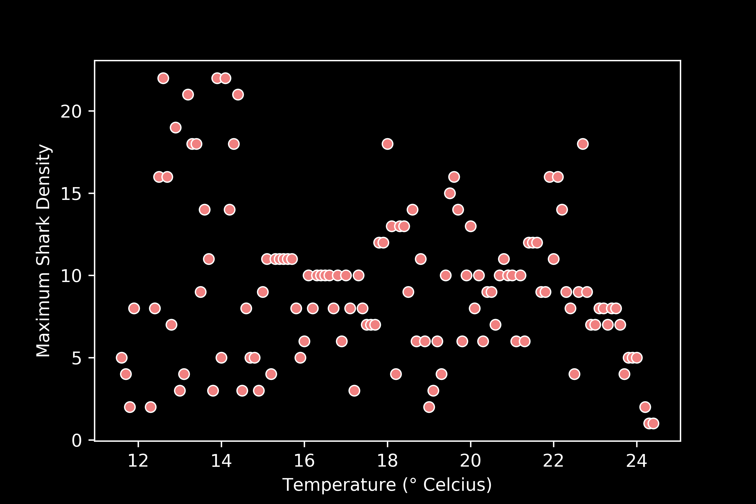
Results: Shark Density v Sea Surface Temperature
Solution: Calculate maximum shark density at each 0.1ºC
Notes:
In acoustic telemetry, fish are typically fitted with acoustic transmitter that emit a sound wave that is picked up by underwater acoustic receivers. The receiver records the date, time, and tagID of the individual that was within its detection range.
The transmitters used for this study were Vemco V9 transmitters. they randomly send out a signal every 100 to 180 seconds, have a battery life of about one year, and a nominal detection distance of about 500 m.

Slide 27
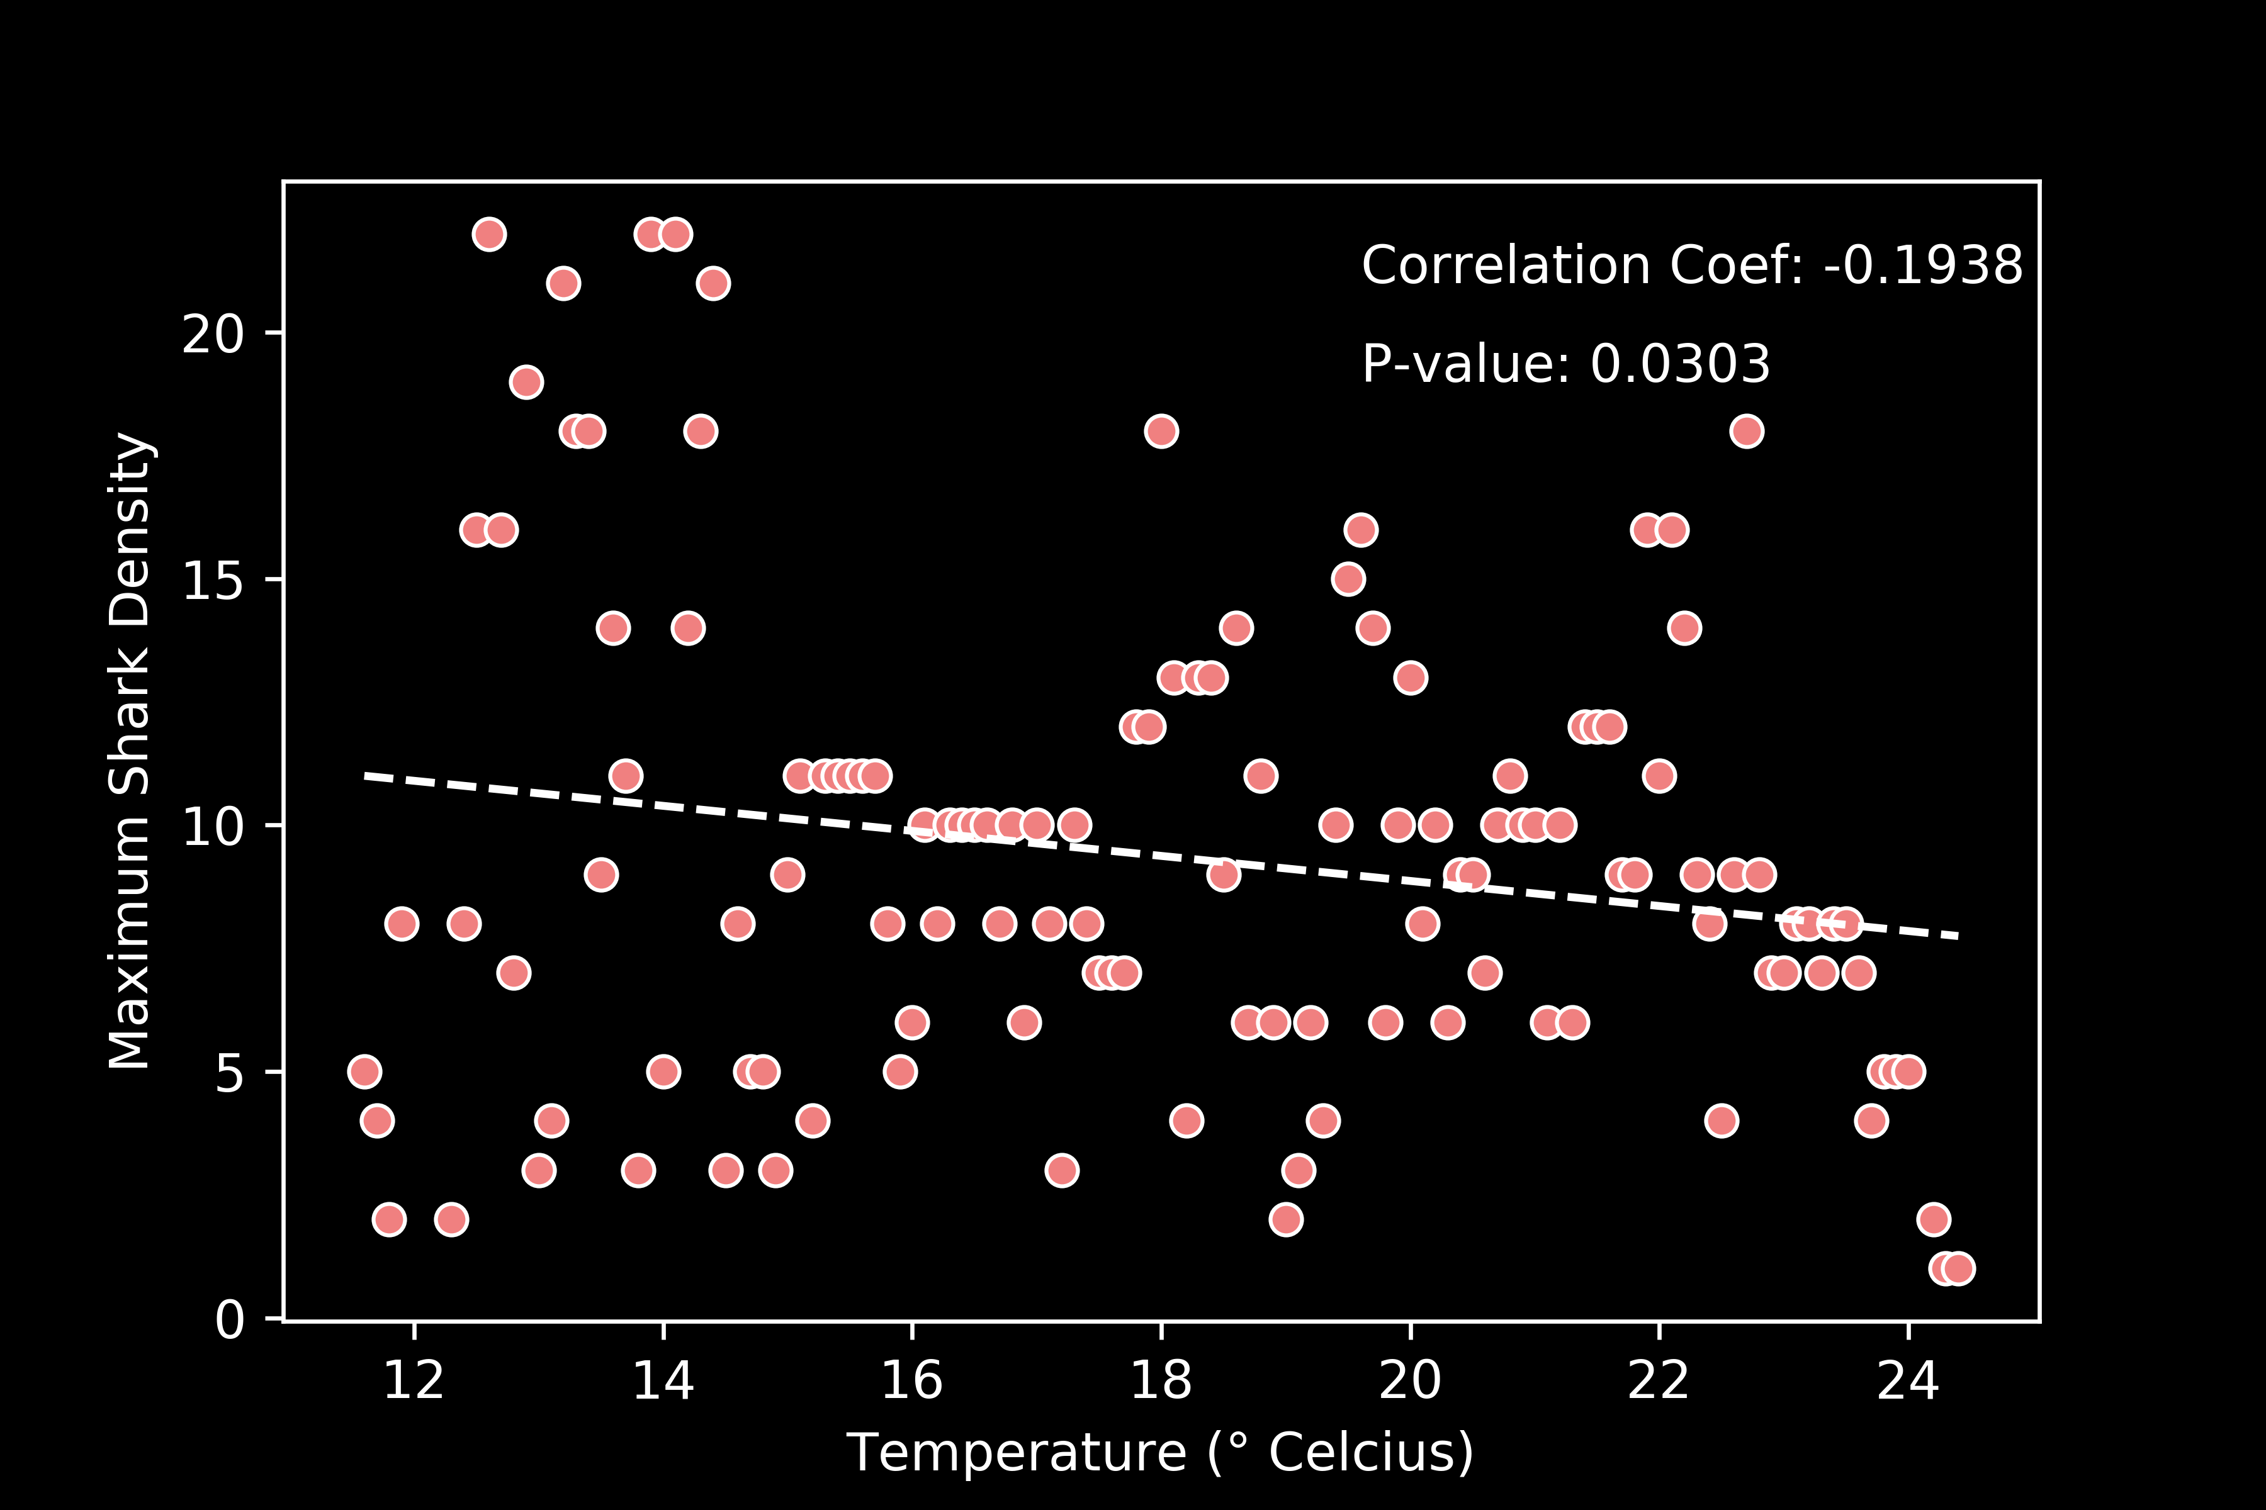
Results: Shark Density v Sea Surface Temperature
Correlation Test
Significant relationship, but no clear trend
Appears to have two peaks
Notes:
In acoustic telemetry, fish are typically fitted with acoustic transmitter that emit a sound wave that is picked up by underwater acoustic receivers. The receiver records the date, time, and tagID of the individual that was within its detection range.
The transmitters used for this study were Vemco V9 transmitters. they randomly send out a signal every 100 to 180 seconds, have a battery life of about one year, and a nominal detection distance of about 500 m.

Slide 28
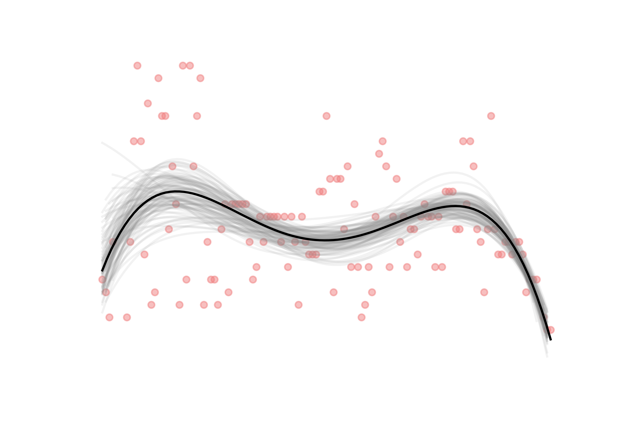
Results: Shark Density v Sea Surface Temperature
Fourth Degree Polynomial (100 iterations)
Fits dataset better, shows two peaks at ~14ºC and 22ºC
Shows relationships across years
Notes:
In acoustic telemetry, fish are typically fitted with acoustic transmitter that emit a sound wave that is picked up by underwater acoustic receivers. The receiver records the date, time, and tagID of the individual that was within its detection range.
The transmitters used for this study were Vemco V9 transmitters. they randomly send out a signal every 100 to 180 seconds, have a battery life of about one year, and a nominal detection distance of about 500 m.

Slide 29

Results: Shark Density v Sea Surface Salinity
Min: 30.00
Max: 39.44
Median: 33.27
STD: 1.34
Highly variable shark densities at all salinity values
Notes:
In acoustic telemetry, fish are typically fitted with acoustic transmitter that emit a sound wave that is picked up by underwater acoustic receivers. The receiver records the date, time, and tagID of the individual that was within its detection range.
The transmitters used for this study were Vemco V9 transmitters. they randomly send out a signal every 100 to 180 seconds, have a battery life of about one year, and a nominal detection distance of about 500 m.

Slide 30

Results: Shark Density v Sea Surface Salinity
Solution: Calculate maximum shark density at each 0.1 psu
Notes:
In acoustic telemetry, fish are typically fitted with acoustic transmitter that emit a sound wave that is picked up by underwater acoustic receivers. The receiver records the date, time, and tagID of the individual that was within its detection range.
The transmitters used for this study were Vemco V9 transmitters. they randomly send out a signal every 100 to 180 seconds, have a battery life of about one year, and a nominal detection distance of about 500 m.

Slide 31
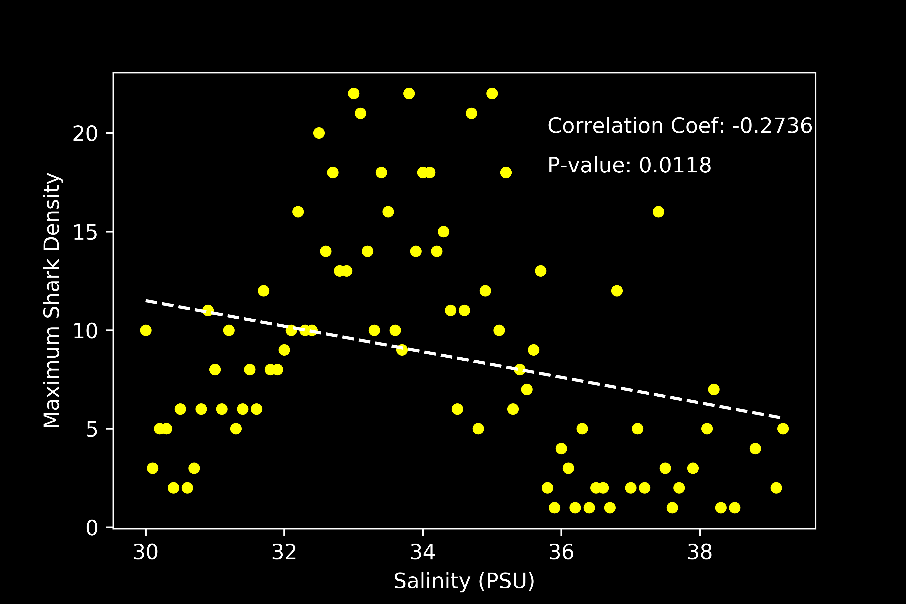
Results: Shark Density v Sea Surface Salinity
Correlation Test
Significant relationship, but no clear trend
Appears to have a single peak that decays quickly
Notes:
In acoustic telemetry, fish are typically fitted with acoustic transmitter that emit a sound wave that is picked up by underwater acoustic receivers. The receiver records the date, time, and tagID of the individual that was within its detection range.
The transmitters used for this study were Vemco V9 transmitters. they randomly send out a signal every 100 to 180 seconds, have a battery life of about one year, and a nominal detection distance of about 500 m.

Slide 32
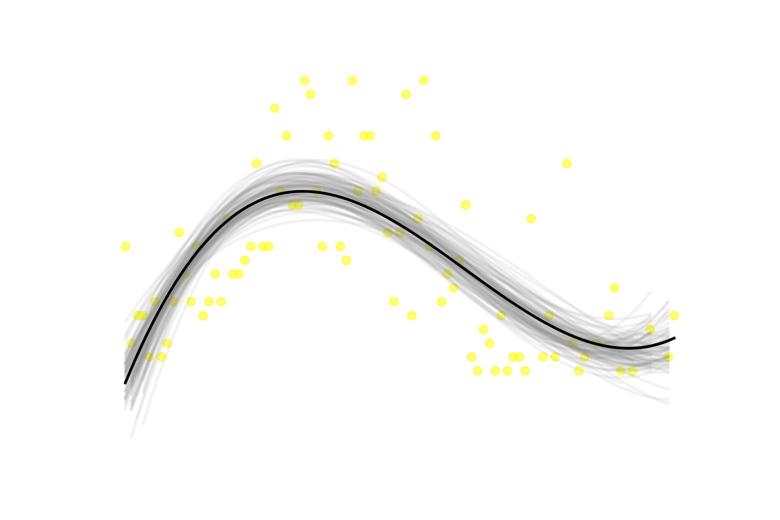
Results: Shark Density v Sea Surface Salinity
Third Degree Polynomial (100 iterations)
Fits dataset better, a peak between 32-36 psu
Notes:
In acoustic telemetry, fish are typically fitted with acoustic transmitter that emit a sound wave that is picked up by underwater acoustic receivers. The receiver records the date, time, and tagID of the individual that was within its detection range.
The transmitters used for this study were Vemco V9 transmitters. they randomly send out a signal every 100 to 180 seconds, have a battery life of about one year, and a nominal detection distance of about 500 m.

Slide 33
Results: Shark Density v Chlorophyll-A
Min: 2.27e-14
Max: 359.25
Median: 0.32
STD: 7.38
Highly variable shark densities at chlorophyll values < 50
Notes:
In acoustic telemetry, fish are typically fitted with acoustic transmitter that emit a sound wave that is picked up by underwater acoustic receivers. The receiver records the date, time, and tagID of the individual that was within its detection range.
The transmitters used for this study were Vemco V9 transmitters. they randomly send out a signal every 100 to 180 seconds, have a battery life of about one year, and a nominal detection distance of about 500 m.

Slide 34

Results: Shark Density v Chlorophyll-A
Solution: Calculate maximum shark density at each 0.1
Doesn’t appear to help the issue
Notes:
In acoustic telemetry, fish are typically fitted with acoustic transmitter that emit a sound wave that is picked up by underwater acoustic receivers. The receiver records the date, time, and tagID of the individual that was within its detection range.
The transmitters used for this study were Vemco V9 transmitters. they randomly send out a signal every 100 to 180 seconds, have a battery life of about one year, and a nominal detection distance of about 500 m.

Slide 35

Results: Shark Density v Chlorophyll-A
Correlation Test
Relationship is not significant; a poor fit
Notes:
In acoustic telemetry, fish are typically fitted with acoustic transmitter that emit a sound wave that is picked up by underwater acoustic receivers. The receiver records the date, time, and tagID of the individual that was within its detection range.
The transmitters used for this study were Vemco V9 transmitters. they randomly send out a signal every 100 to 180 seconds, have a battery life of about one year, and a nominal detection distance of about 500 m.

Slide 36
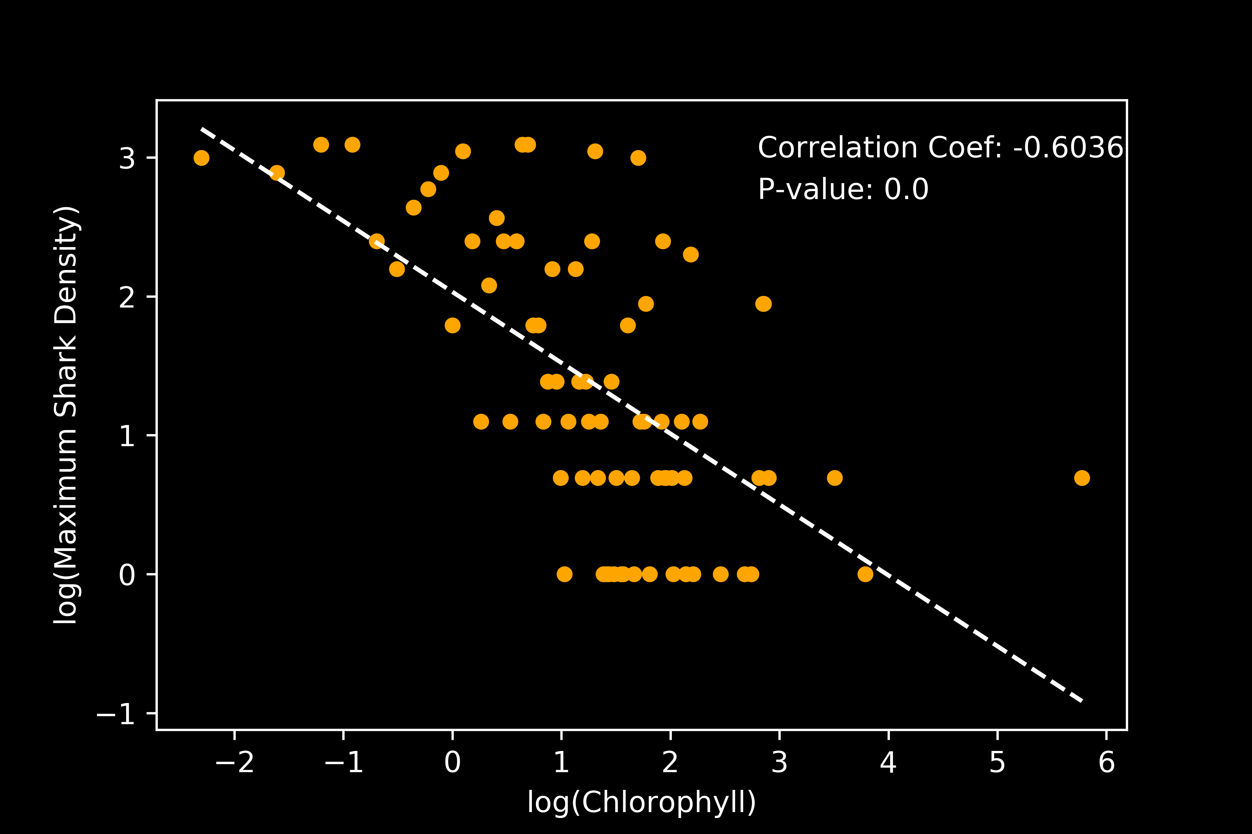
Results: Shark Density v Chlorophyll-A
Solution: log-log transformation and Correlation Test
Significant negative relationship
Notes:
In acoustic telemetry, fish are typically fitted with acoustic transmitter that emit a sound wave that is picked up by underwater acoustic receivers. The receiver records the date, time, and tagID of the individual that was within its detection range.
The transmitters used for this study were Vemco V9 transmitters. they randomly send out a signal every 100 to 180 seconds, have a battery life of about one year, and a nominal detection distance of about 500 m.

Slide 37
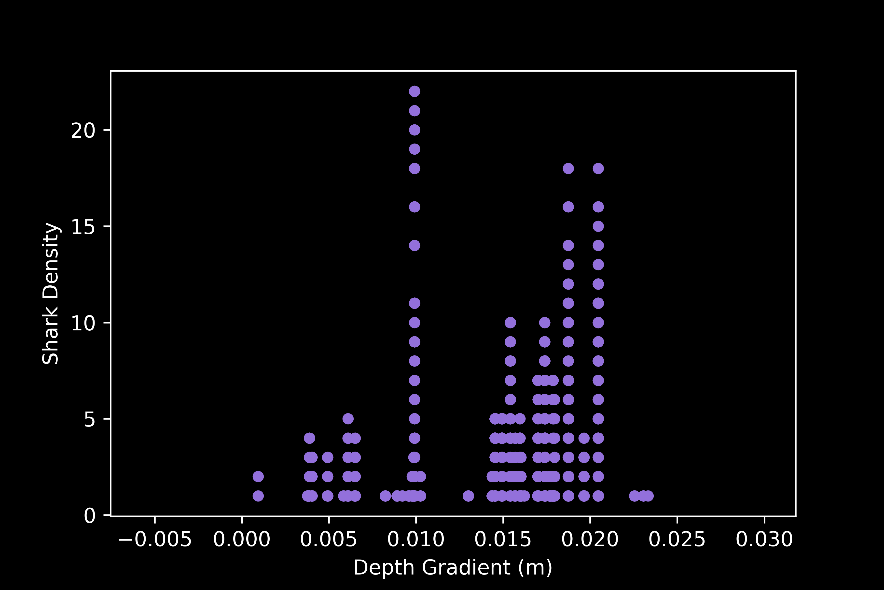
Results: Shark Density v Seafloor Depth Gradient
Min: 0.0009
Max: 0.023
Median: 0.007
STD: 0.005
Highly variable shark densities most gradient values
Notes:
In acoustic telemetry, fish are typically fitted with acoustic transmitter that emit a sound wave that is picked up by underwater acoustic receivers. The receiver records the date, time, and tagID of the individual that was within its detection range.
The transmitters used for this study were Vemco V9 transmitters. they randomly send out a signal every 100 to 180 seconds, have a battery life of about one year, and a nominal detection distance of about 500 m.

Slide 38
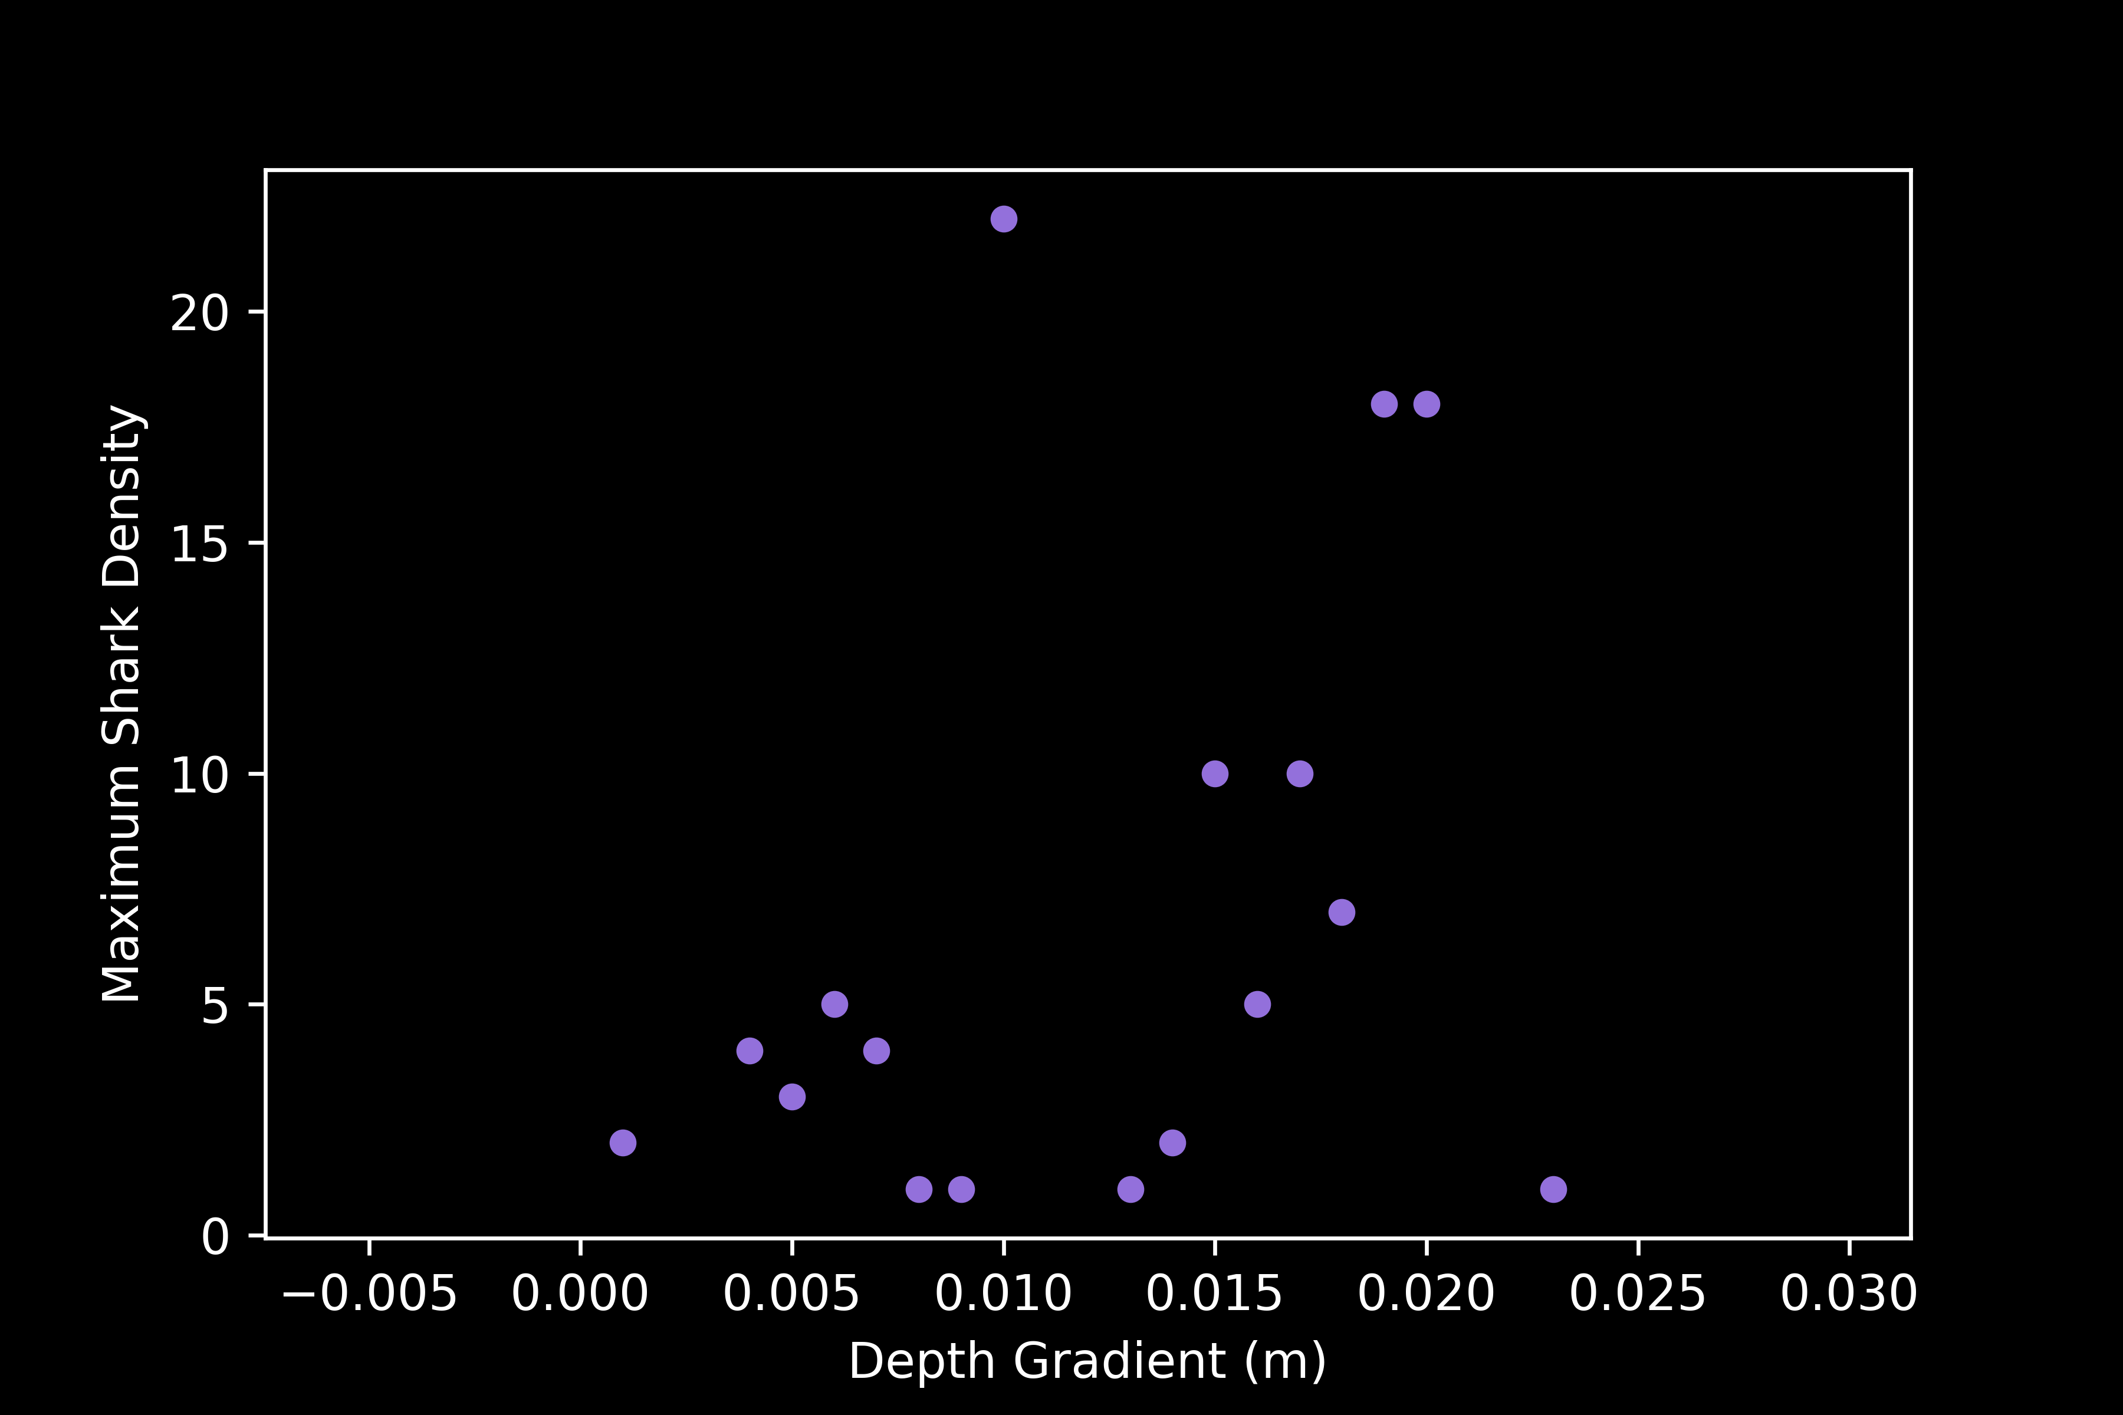
Results: Shark Density v Seafloor Depth Gradient
Solution: Calculate maximum shark density at each 0.001
Notes:
In acoustic telemetry, fish are typically fitted with acoustic transmitter that emit a sound wave that is picked up by underwater acoustic receivers. The receiver records the date, time, and tagID of the individual that was within its detection range.
The transmitters used for this study were Vemco V9 transmitters. they randomly send out a signal every 100 to 180 seconds, have a battery life of about one year, and a nominal detection distance of about 500 m.

Slide 39
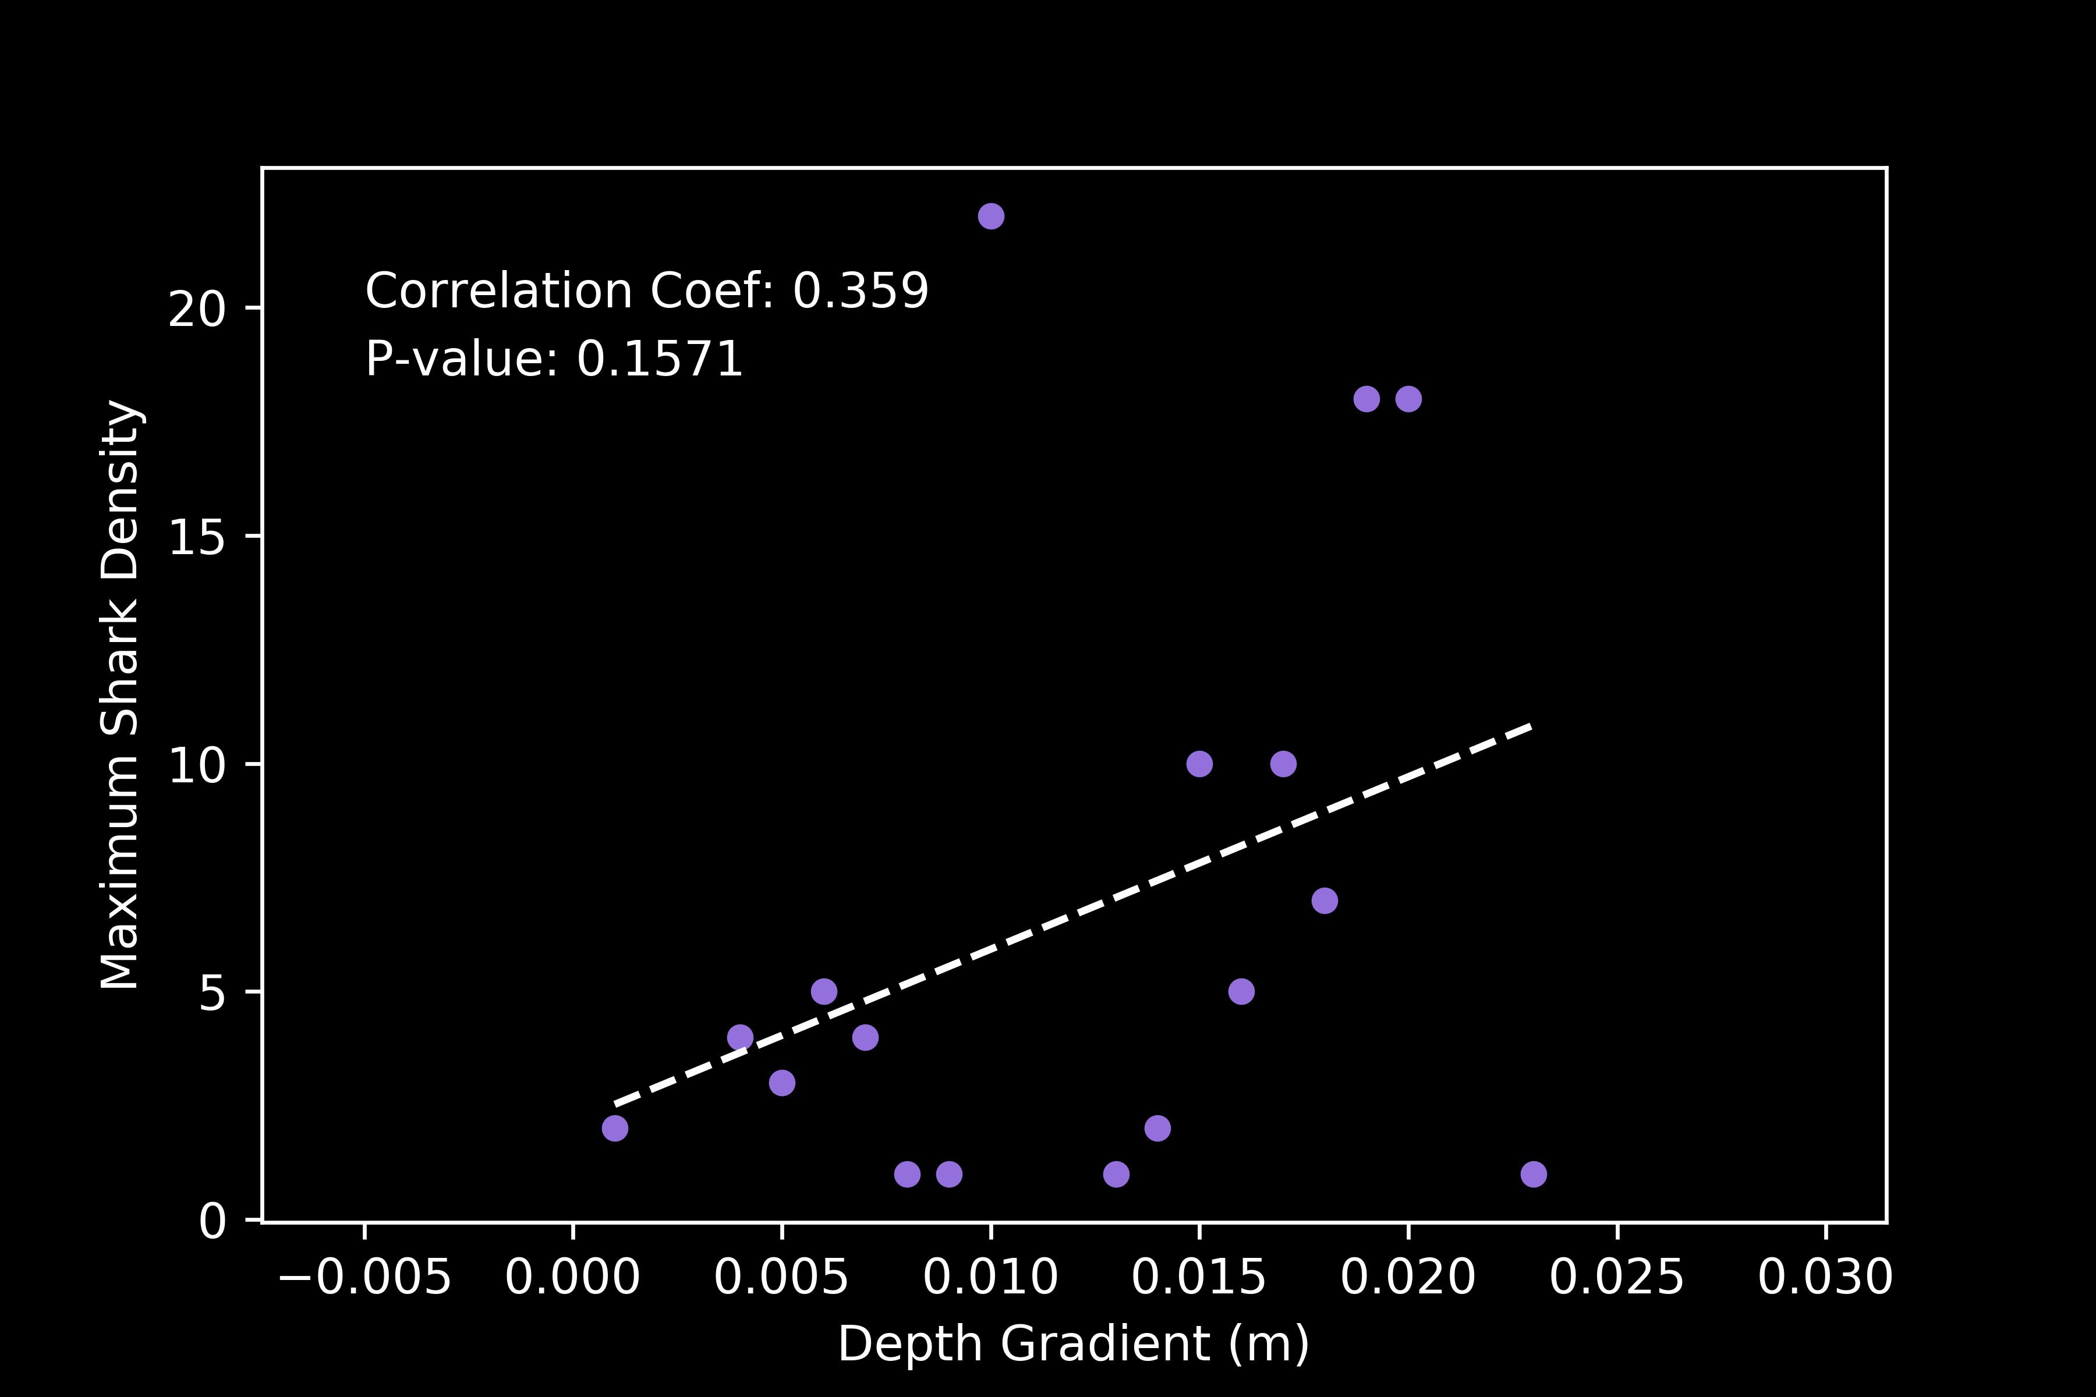
Results: Shark Density v Seafloor Depth Gradient
Correlation Test
Relationship is not significant; a poor fit
Notes:
In acoustic telemetry, fish are typically fitted with acoustic transmitter that emit a sound wave that is picked up by underwater acoustic receivers. The receiver records the date, time, and tagID of the individual that was within its detection range.
The transmitters used for this study were Vemco V9 transmitters. they randomly send out a signal every 100 to 180 seconds, have a battery life of about one year, and a nominal detection distance of about 500 m.

Slide 40
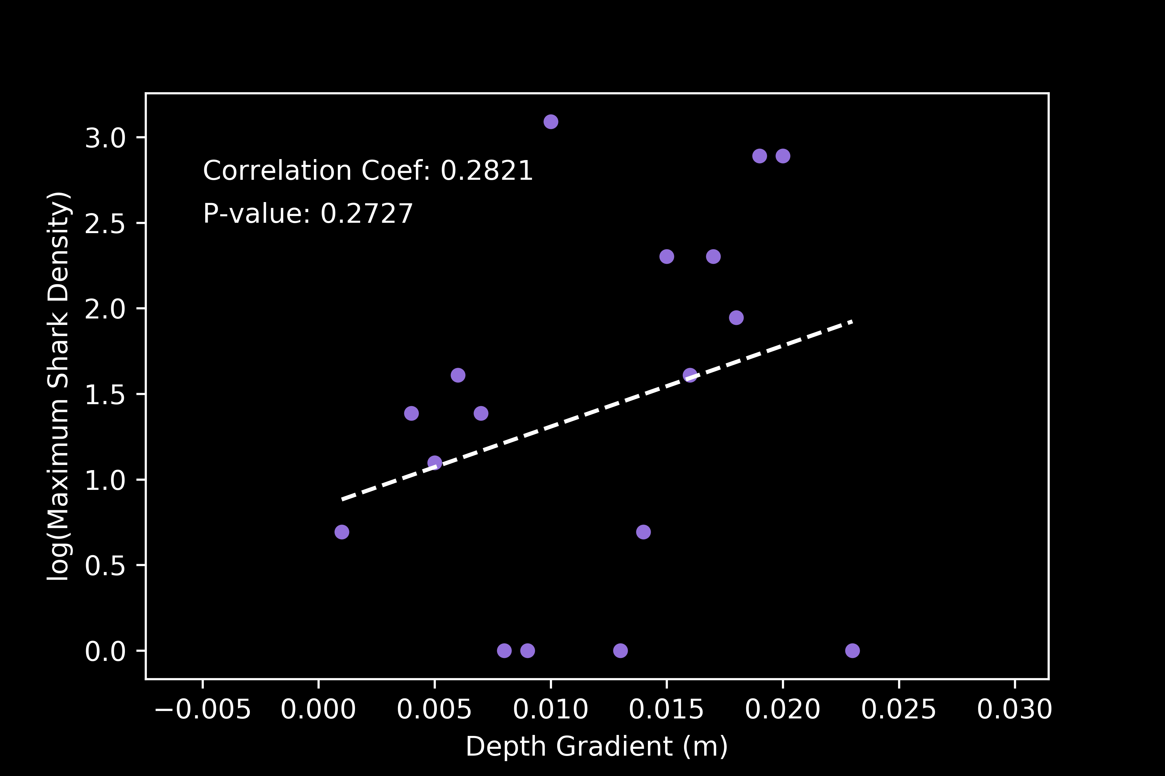
Results: Shark Density v Seafloor Depth Gradient
Solution: log transformation of Shark Density
Correlation Test
The relationship is still not significant
Notes:
In acoustic telemetry, fish are typically fitted with acoustic transmitter that emit a sound wave that is picked up by underwater acoustic receivers. The receiver records the date, time, and tagID of the individual that was within its detection range.
The transmitters used for this study were Vemco V9 transmitters. they randomly send out a signal every 100 to 180 seconds, have a battery life of about one year, and a nominal detection distance of about 500 m.

Slide 41
Discussion: Shark Density v Seafloor Depth Gradient
The relationship is still not significant
There may not be a wide enough spread of depth gradient values to calculate such a relationship
Notes:
In acoustic telemetry, fish are typically fitted with acoustic transmitter that emit a sound wave that is picked up by underwater acoustic receivers. The receiver records the date, time, and tagID of the individual that was within its detection range.
The transmitters used for this study were Vemco V9 transmitters. they randomly send out a signal every 100 to 180 seconds, have a battery life of about one year, and a nominal detection distance of about 500 m.

Slide 42
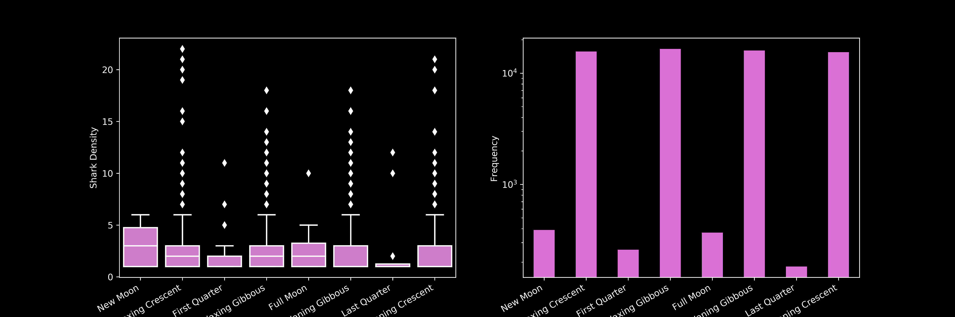
Results: Shark Density v Lunar Phase
Ordinary Least Squares ANOVA
Shark Density across lunar phases
No significant difference (p > 0.05)
Notes:
In acoustic telemetry, fish are typically fitted with acoustic transmitter that emit a sound wave that is picked up by underwater acoustic receivers. The receiver records the date, time, and tagID of the individual that was within its detection range.
The transmitters used for this study were Vemco V9 transmitters. they randomly send out a signal every 100 to 180 seconds, have a battery life of about one year, and a nominal detection distance of about 500 m.

Slide 43
Discussion: Shark Density v Lunar Phase
No significant difference (p > 0.05)
Juvenile White Shark movements are not driven by the lunar cycle
Notes:
In acoustic telemetry, fish are typically fitted with acoustic transmitter that emit a sound wave that is picked up by underwater acoustic receivers. The receiver records the date, time, and tagID of the individual that was within its detection range.
The transmitters used for this study were Vemco V9 transmitters. they randomly send out a signal every 100 to 180 seconds, have a battery life of about one year, and a nominal detection distance of about 500 m.

